Slide 1
Primary BILIARY CHOLANGITIS
Histological criteria, recent proposal for staging, biology of main autoantibodies
Irene Esposito
Institute of Pathology – University Hospital of Dusseldorf - Germany

Slide 2
Disclosure of Relevant Financial Relationships
Dr. Esposito declares he/she has no
conflict(s) of interest to disclose
RDC Nº 96/08 da ANVISA

Slide 3

The Oberkassel bridge

Slide 4
Agenda
Classification of immune-related cholangiopathies
PBC – etiology, pathogenesis, clinical features
PBC – Role of autoantibodies
PBC - Morphology
PBC – Grading & Staging

Slide 5

Definition & Classification
Immune-mediated cholangiopathies: chronic cholestatic disorders driven by auto- and allo-immunity
Entities:
Primary sclerosing cholangitis
Primary biliary cholangitis
IgG4-related sclerosing cholangitis
Graft-versus-host disease
Hepatic allograft rejection
Common feature: accumulation of T-cells at the site of bile-duct damage/destruction

Slide 6
PBC: Clinical aspects
Rare disease, incidence 0.9-5.2/100,000 people/year; increasing
F>>>>>>M (10:1), mean age 55 years
Laboratory: Chronic cholestasis (ALP 2-3x; γGT 5-6x), slight AST/ALT increase, bilirubin only in late stages
Autoantibodies: AMA-M2, ANA: anti Sp100 & anti-gp210
Other findings: IgM, hyperlipidaemia
Symptoms: fatigue, pruritus, hyperpigmentation, sign of cirrhosis
Risk of HCC
Association with other autoimmune disorders (Hashimoto thyreoiditis, Sjögren‘s syndrome)
Sarcognato et al, Pathologica 2021

Slide 7
PBC: Pathogenesis
Genetic (e.g. HLA) and environmental factors (hair dyes, nail polish, cigarette smoking?)
Non HLA-genes: genes involved in the regulation of the immune system and antigen presentation, such as IL-1RL1, STAT4, STAT1, and IL12A
Infections (molecular mimicry); chemical factors may break self-tolerance
Cholangiocyte is the target cell and may act as APC increasing inflammation and epithelial cell lysis

Slide 8
Pathogenesis of PBC
Li et al, Biomed Pharmacother 2021

Slide 9
PBC: Autoantibodies
AMA-M2: antimitochondrial antibodies (>90% of pts)
Directed against the E2 subunits of the 2-oxo acid dehydrogenase complexes (PDC-E2) and other antigens present on the inner mitochondrial membrane, exposed after apoptosis of the biliary cells
It has a predictive value: titers of 1:320 and 1:640 increase the OR of developing PBC of 4.93 and 7.67, respectively
No prognostic value, no value in predicting therapy response
Present in 0.1% of the general population, so not specific für PBC
Colapietro et al, Clin Rev Allergy Immunol 2022

Slide 10
PBC: Autoantibodies
Sp-100: directed against a nuclear antigen
may predict response to UDCA but also disease progression (fibrosis)
gp210: directed against a glycoprotein of the nuclear pore complex
- Predictive of poor outcomes and PBC progression (e.g. liver failure)
Sp-100 and gp210 antibodies are present in 30-50% PBC patients and
may be useful for diagnosis in AMA-M2-negative PBC (5% of patients)
Huang et al, Dis Markers 2019
Sarcognato et al, Pathologica 2021

Slide 11
PBC: Pathology – General aspects
PBC is a disease of the small intrahepatic bile ducts
Liver biopsy is useful in AMA-M2-negative pts, in mixed cholestatic and hepatitic
presentations, to exclude comorbidities (e.g. NAFLD) and for staging
The changes can be unevenly distributed -> serial sections
PBC-AIH overlap is rare

Slide 12
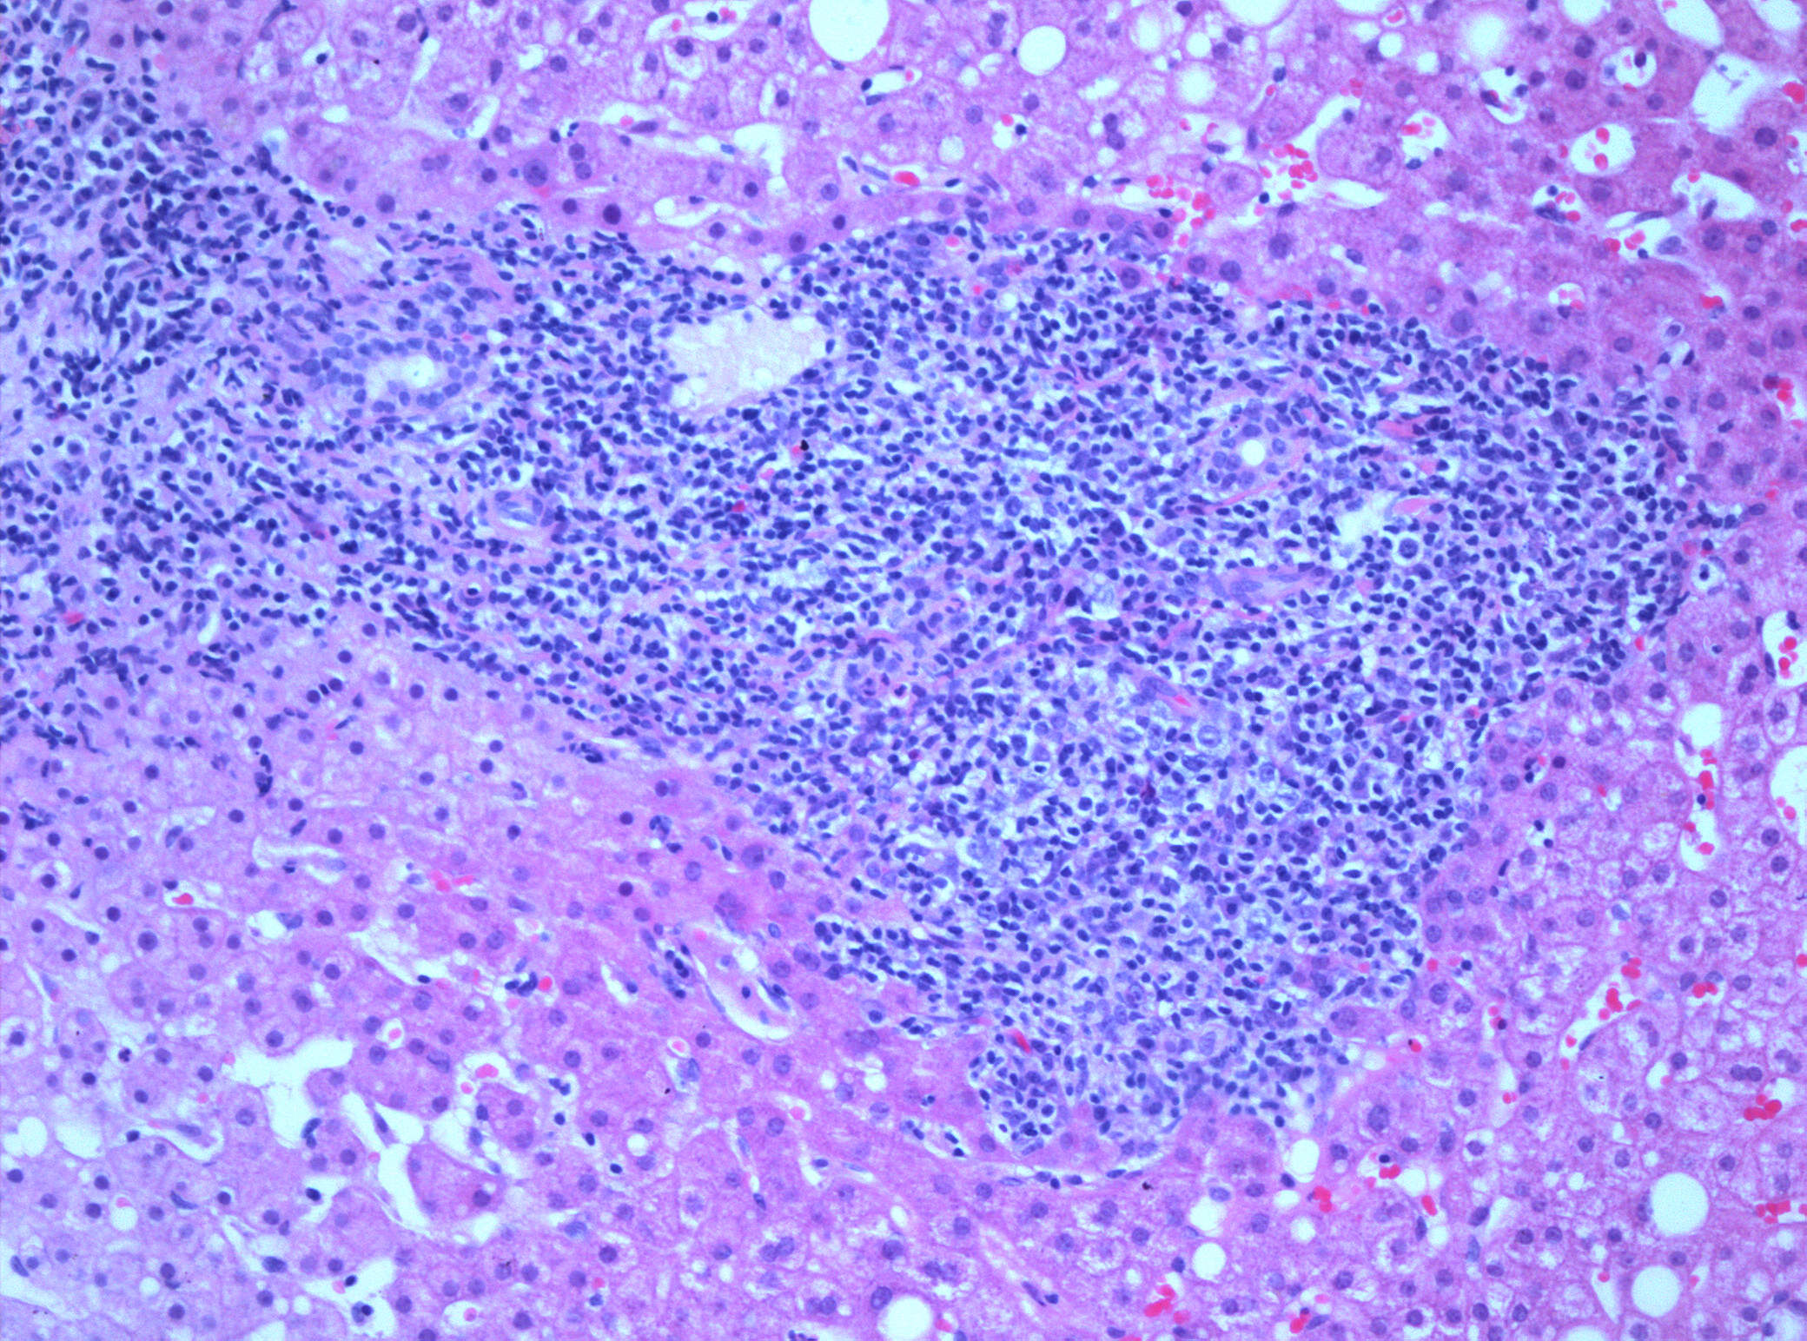
Expanded, „round“ portal tracts
Lymphoplasmacellular infiltration around and within bile ducts
Usually not prominent interface activity

Slide 13
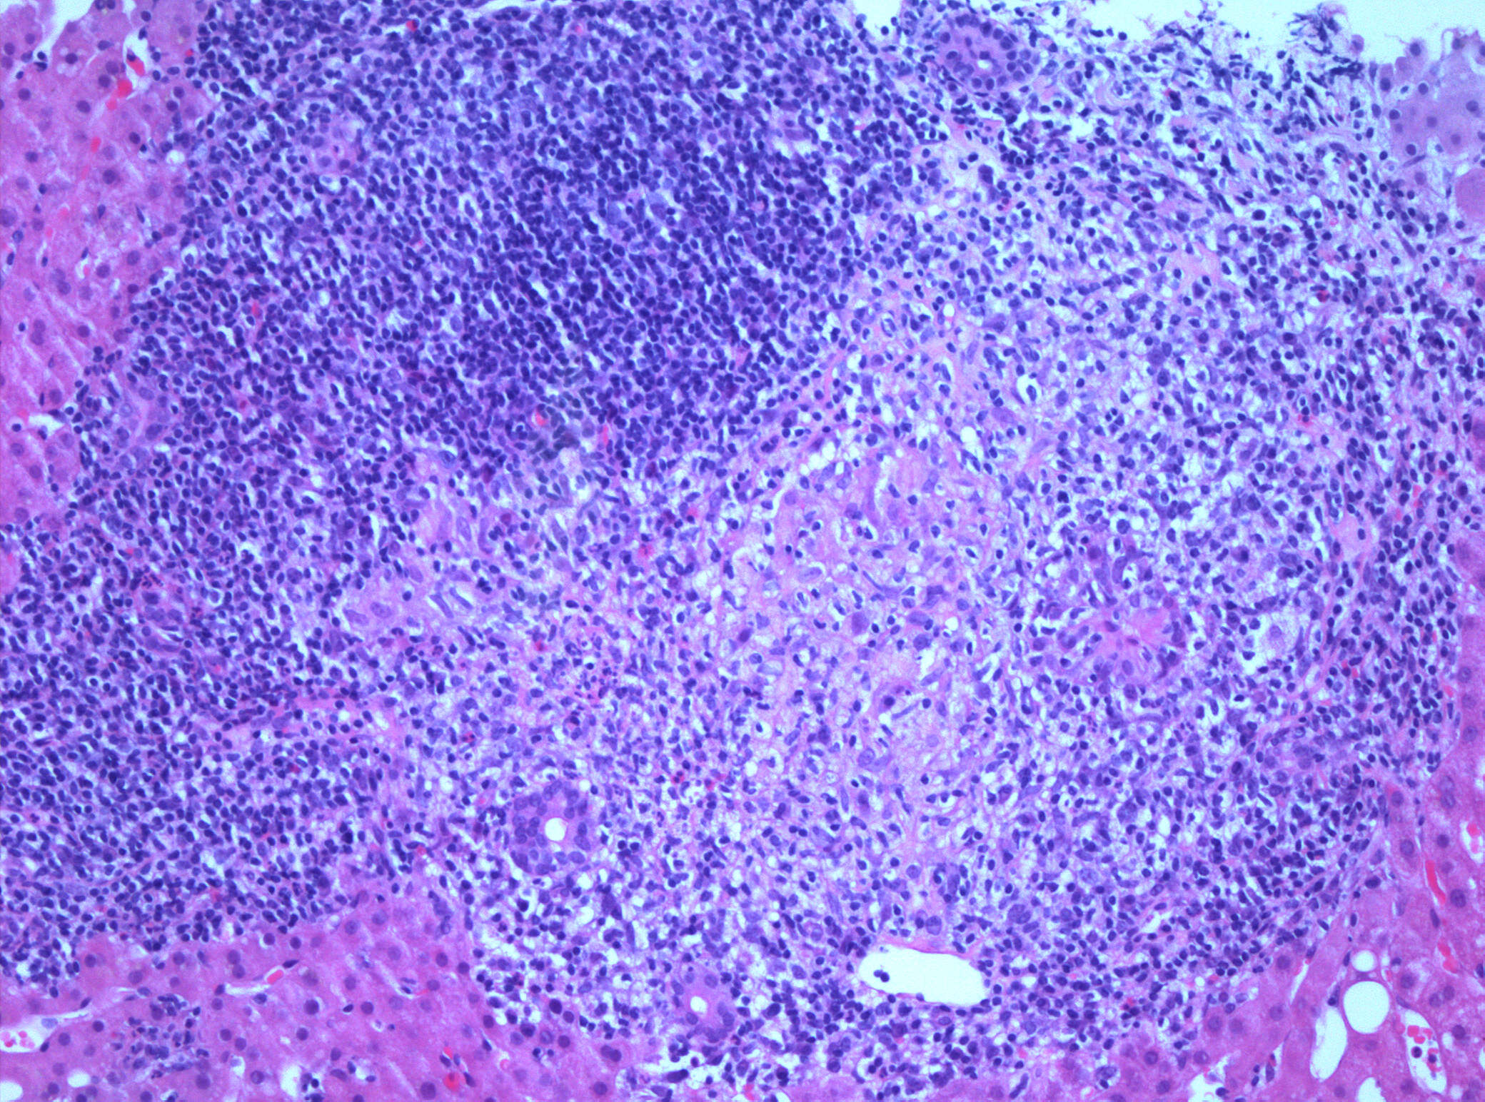
Portal granuloma with bile duct vicinity/involvement

Slide 14
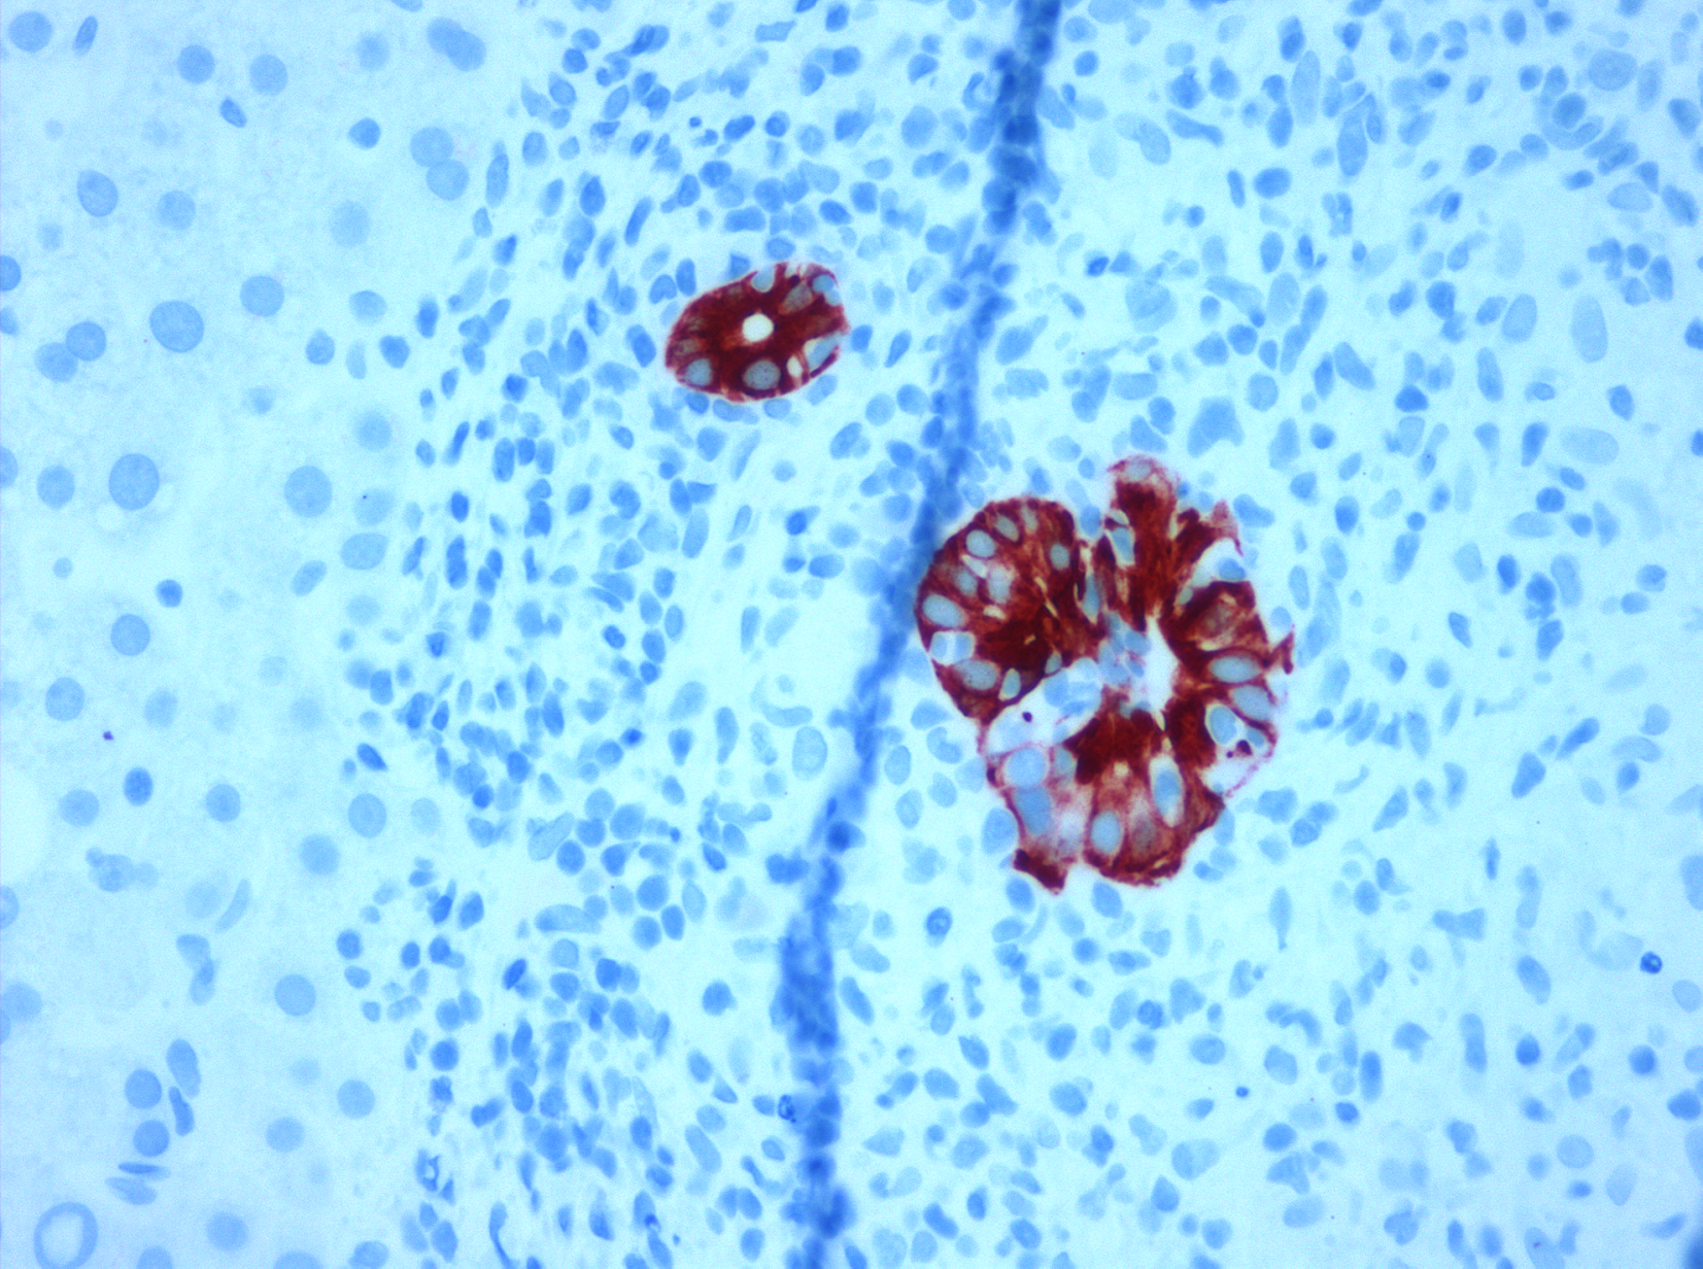
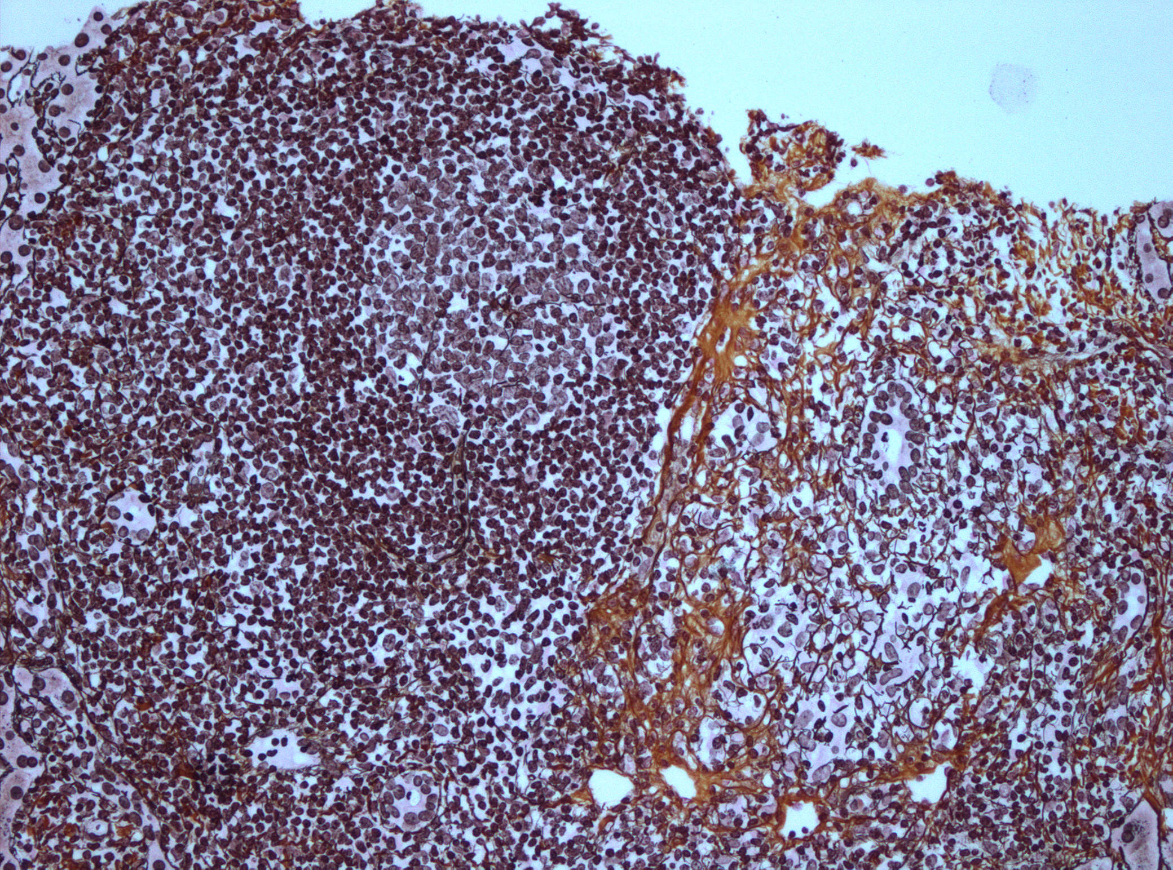
Florid duct lesion:
chronic non-suppurative destructive (lymphocytic) cholangitis (CNSDC)
Beginning periductal fibrosis, portal lymph follicle with germinal center
CK7

Slide 15
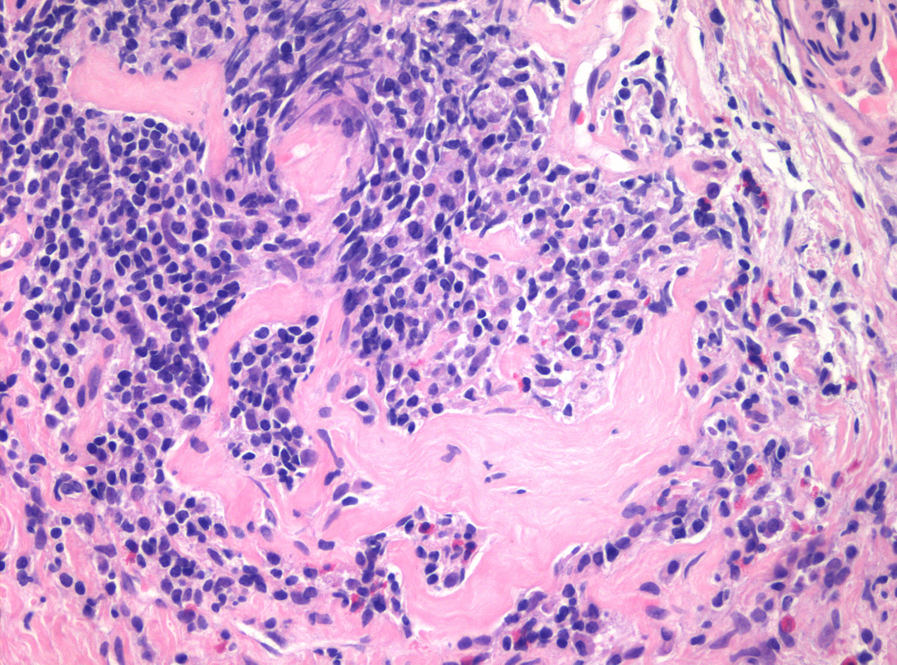
Portal hyaline sclerosis

Slide 16
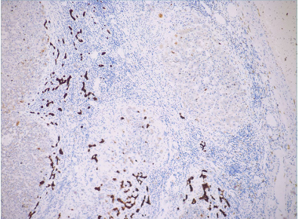
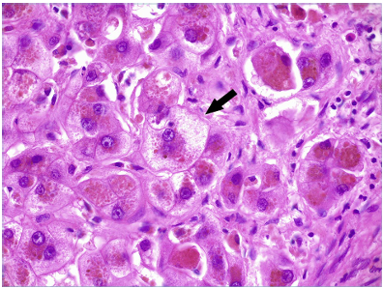
Ductular reaction, ductopenia
and biliary configuration of PT
Chronic cholestasis with feathery degeneration

Slide 17
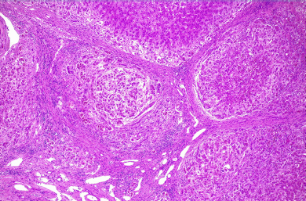
Biliary cirrhosis with „halo“ effect

Slide 18
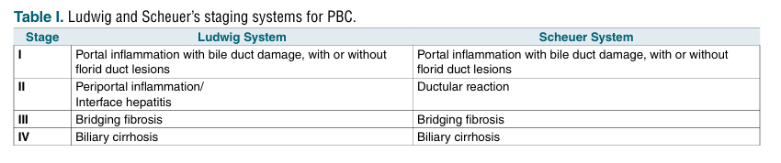
Staging - PBC
Ludwig et al.; Scheuer et al. (1967)

Slide 19
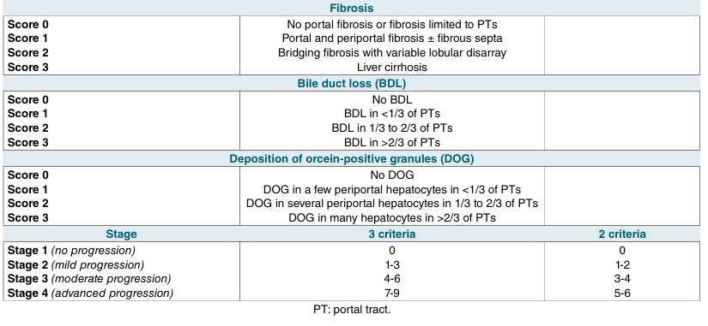
Nakanuma Staging and Grading
Harada et al, J Clin Gastroenterol 2013

Slide 20
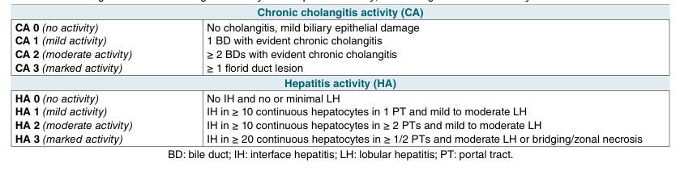
Nakanuma Staging and Grading
Harada et al, J Clin Gastroenterol 2013

Slide 21
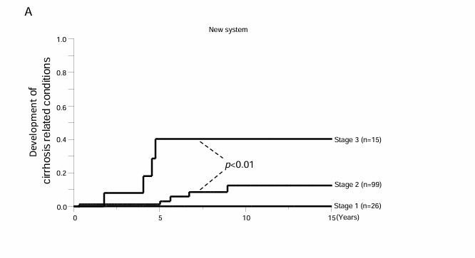
Better prediction of patients‘ outcome
compared with previous systems
Kakuda et al, Hum Pathol 2013

Slide 22
Indication for liver biopsy
Diagnosis in AMA-M2-negative forms
Comorbidities/Overlap
Staging (Prognosis, LTx)
Follow-up
Recurrence (LTx)

Slide 23

The Königsallee

